Slide 1
Tutorial 8 / FAQ Revision
By Jeremy Lim

Slide 2
Survey Results
What topics do you want to revise in the last few tutorials?
FP(in terms of code example, how to determine when to use), abstract classes and interfaces (when to decide to use them), Generics (quite completely lost on this topic)
Functional Interfaces, Abstract Classes and BiFunction
Consumer/Supplier Concurrency versus parallelism Generics (Extends, Super)
Generics, wildcards, exceptions, Java's memory model
Abstract classes, interfaces, exceptions
Exceptions, Java's memory model
Generics, e.g. when do i have to define <T,U>..
Functional Programming (Functional Interfaces and Infinite Streams)
Infinite list
Anonymous classes, Testability of classes
java generics onwards!!
Generics, Consumer and Supplier & its applications
Nice Try

Slide 3
Survey Results
FP
Exceptions
Generics
Memory Model
Concurrency vs Parallelism (x1)
Testability (x1) [See tutorial 5]
Anonymous classes (x1) [See tutorial 6 and tutorial 5 example code]

Slide 4
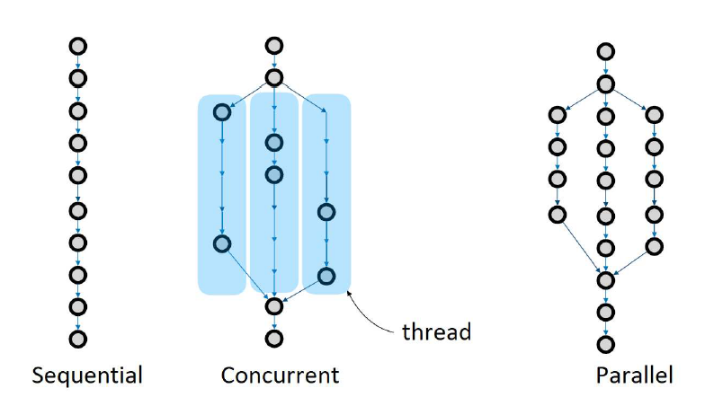
Concurrency vs Parallelism
Each circle = line of code / unit of work
Why concurrency? Manage data separately between different threads
Multiple threads, but 1 task at a time

Slide 5
Concurrency vs Parallelism
Parallel with 1 CPU is same as concurrent
Each circle = line of code / unit of work
Multiple threads, each task on a different CPU
3x execution speed

Slide 6
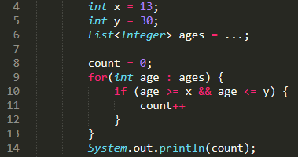
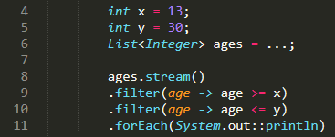
FP concrete example – When to use?
Given list of ages, find the percentage of people between ages x and y
Normal imperative way
FP way
✅ More readable
❌ Probably slower

Slide 7
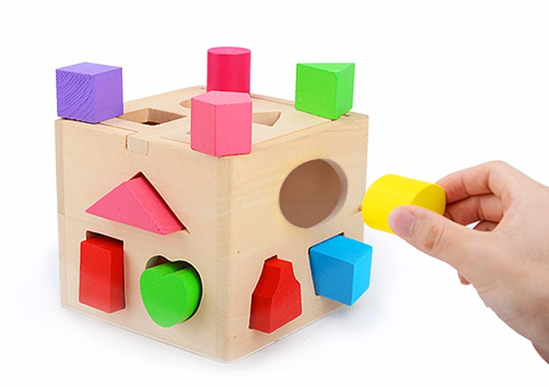
Functional Interfaces
Some method
If your lambda has the same
Input (types and count)
Output
as the interface’s abstract method:
Your lambda will automatically implement it!
The argument accepts some interface
Your lambda
Other arguments on NUSWhispers

Slide 8


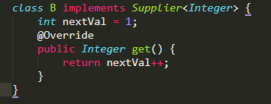

Consumers and Suppliers – When do you use them?
All the time in FP, you just don’t realise it / Use it when the method uses it
This uses a supplier
This is a consumer
This defines a supplier

Slide 9
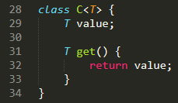

Generics
Generics defined in class declaration:
Same T everywhere in the class
T will be bound to the type of the variable
T inferred as Integer from the type

Slide 10
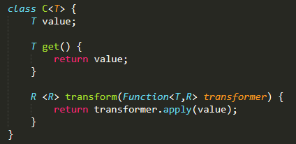
Generics
Generics defined in method:
Only used within the method itself
R is bound to wherever it is used in an argument
<R> tells Java that you are using a new generic type

Slide 11
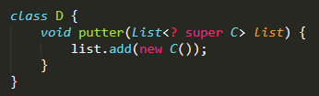
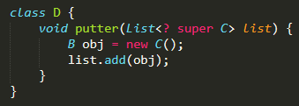
Generics
B extends A
C extends B
List can be List<A>, List<B> or List<C>
Suppose we pass in a List<B>:
list.add() accepts instance of B
Since C extends B, C can be stored in a variable of type B, so can be added
Same

Slide 12
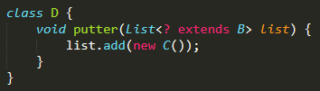
Generics
B extends A
C extends B
Suppose we pass in List<B>:
B can have multiple subclasses
Can’t guarantee List will accept C
What if we passed in List<E>?
List<B> accepts C
B
C
E
List<C> accepts C
List<E> does not accept C

Slide 13


Generics
B extends A
C extends B
List can be List<A>, List<B> or List<C>
Suppose we pass in a List<B>:
list.get(0) returns a B instance
Since B extends A, this B instance can be returned as A!
❌
If we pass in List<B>:
B is not a superclass of A fail to compile
B
I
C

Slide 14
See standalone revision slides for more

Slide 15
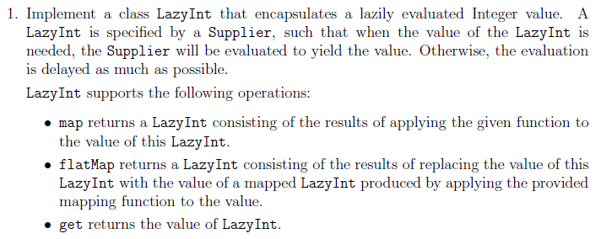
Q1: LazyInt

Slide 16
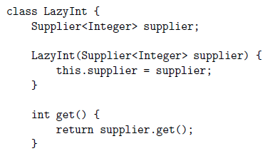
Q1: LazyInt

Slide 17
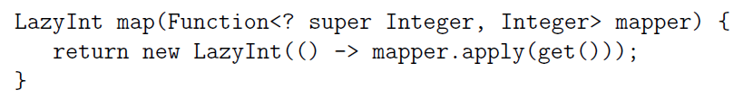

Q1: LazyInt
Not evaluating the mapper Defining a supplier that will apply to the current LazyInt’s value
Mapper
Mapper
LazyInt 3
LazyInt 1
LazyInt 2

Slide 18
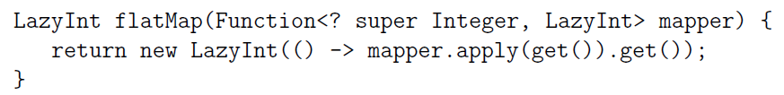
Q1: LazyInt
Call get() on the new LazyInt 2:
New instance
LazyInt 1.get()
Integer
mapper
LazyInt
LazyInt 3.get()
Integer

Slide 19
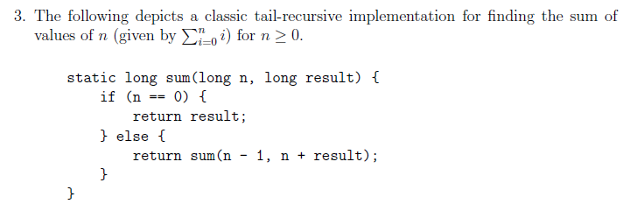
Q3: Possible exam-style qns?
(Try on your own if you can’t follow)
TL;DR sum(n,r) = sum(n-1, n+r+1) = sum(n-2, n+r+1+r+2) = … = sum(0,result)
sum
sum
sum
sum
Problem: Call stack overflow for large n
Want: Lazy evaluation for each recursion
sum
sum
TL;DR sum(n,r) = sum(n-1, r+1) = sum(n-2, r+2) = … = sum(0,r)
Basically code version of a formal definition of +
If you think this is stupid stay away from CS3234 ☺

Slide 20
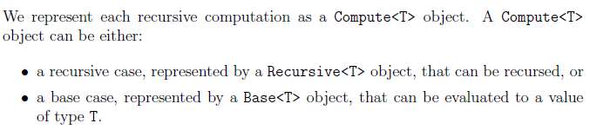
Q3: Possible exam-style qns?
Compute<T>
Exam and practical test hint:
HINTS ARE SUPER OBVIOUS.
Recursive<T>
Base<T>

Slide 21

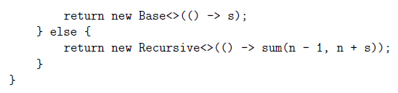
Q3: Possible exam-style qns?
Clearly suppliers

Slide 22
Q3: Possible exam-style qns?
Clearly suppliers
Returns Long
Returns Compute<Long>

Slide 23
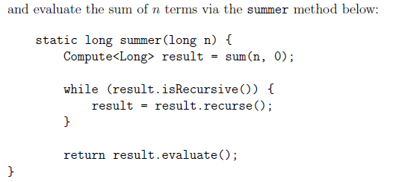
Q3: Possible exam-style qns?
Compute<T> has method recurse that returns Compute<T>
Evaluate returns long

Slide 24
What do we know?
Compute<T>
Compute<T>
bool isRecursive()
long evaluate()
Compute<T> recurse()
Base<T>
Constructor Base(Supplier<T>)
Recursive<T>
Constructor Recursive(Supplier<Compute<T>>)
Recursive<T>
Base<T>
Initialisation:
^ Returns Recursive<Long> for n > 0

Slide 25
What do we know?
Compute<T>
Compute<T>
bool isRecursive()
long evaluate()
Compute<T> recurse()
Base<T>
Constructor Base(Supplier<T>)
Recursive<T>
Constructor Recursive(Supplier<Compute<T>>)
recurse() calls sum() from the supplier
Recursive<T>
Base<T>
Initialisation:
^ Returns Recursive<Long> for n > 0

Slide 26
What do we know?
Compute<T>
Compute<T>
bool isRecursive()
long evaluate()
Compute<T> recurse()
Base<T>
Constructor Base(Supplier<T>)
recurse() does nothing (is base case)
evaluate() returns result
Recursive<T>
Constructor Recursive(Supplier<Compute<T>>)
recurse() calls sum() from the supplier
evaluate() does nothing
Recursive<T>
Base<T>
Initialisation:
^ Returns Recursive<Long> for n > 0

Slide 27
What do we know?
Compute<T>
bool isRecursive()
long evaluate()
Compute<T> recurse()
Base<T>
Constructor Base(Supplier<T>)
recurse() does nothing (is base case)
evaluate() returns result
isRecursive() = false
Recursive<T>
Constructor Recursive(Supplier<Compute<T>>)
recurse() calls sum() from the supplier
evaluate() does nothing
isRecursive() = true
Compute<T>
Recursive<T>
Base<T>
Initialisation:
^ Returns Recursive<Long> for n > 0

Slide 28
What do we know?
This is an interface!
Compute<T>
bool isRecursive()
long evaluate()
Compute<T> recurse()
Base<T>
Constructor Base(Supplier<T>)
recurse() does nothing (is base case)
evaluate() returns result
isRecursive() = false
Recursive<T>
Constructor Recursive(Supplier<Compute<T>>)
recurse() calls sum() from the supplier
evaluate() does nothing
isRecursive() = true
Compute<T>
Recursive<T>
Base<T>
Initialisation:
^ Returns Recursive<Long> for n > 0

